Slide 1

ClinicalNER: Enhancing Medical Document Analysis with Named Entity Recognition
Evaluated By:
ZAHIR Jihad
Presented By:
ABOUHANE Zahra, BAZGOUR Yassine

Slide 2
Diagram of The Workflow
01

Slide 3





Data.csv
BiLSTM
Results
Data.csv
Data Collection
Data
Preprocessing
Data
Annotation
Results
BiLSTM + CRF
Data.tsv
BioBERT
Results

Slide 4
Data Sources
02

Slide 5

https://pubmed.ncbi.nlm.nih.gov/

Slide 6
Type and Format
03

Slide 7
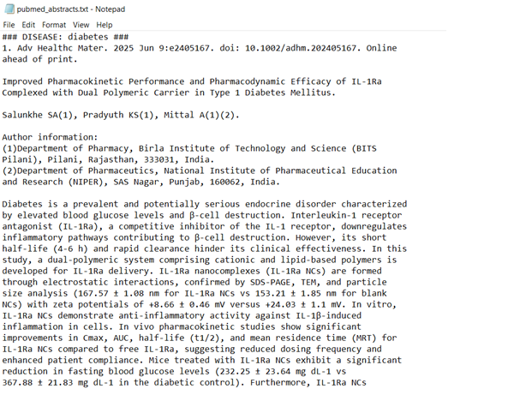

Slide 8
Data Collection
04

Slide 9
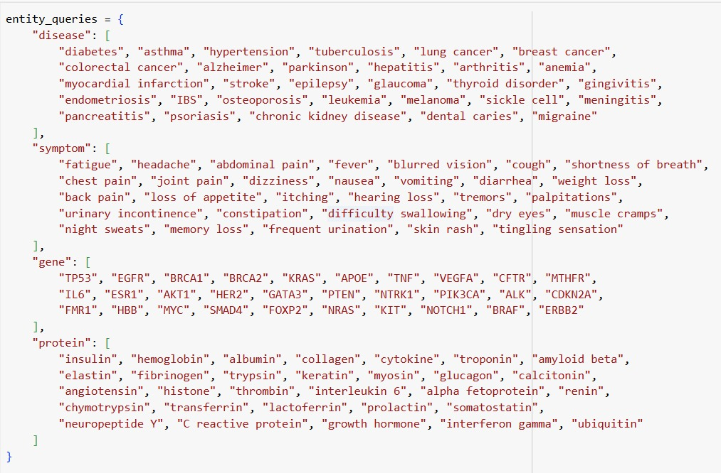

Slide 10
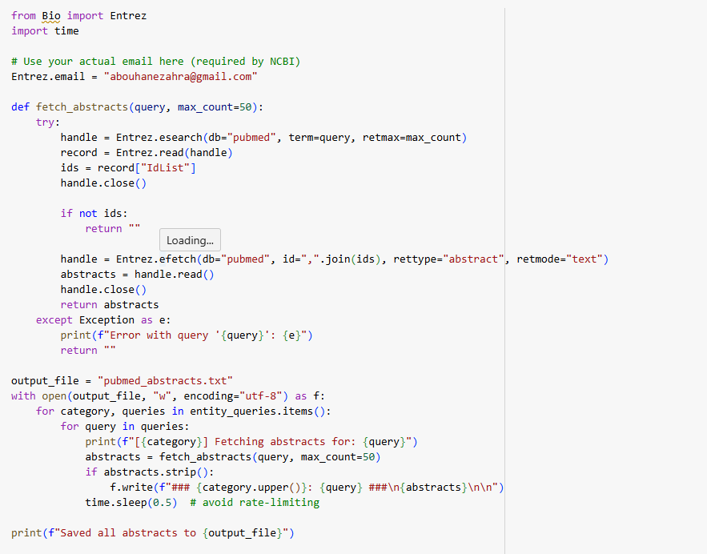

Slide 11
Data Preprocessing
05

Slide 12




Clean
Data
Lowercase
Data
Data
Tokenization
Data
Segmentation

Slide 13
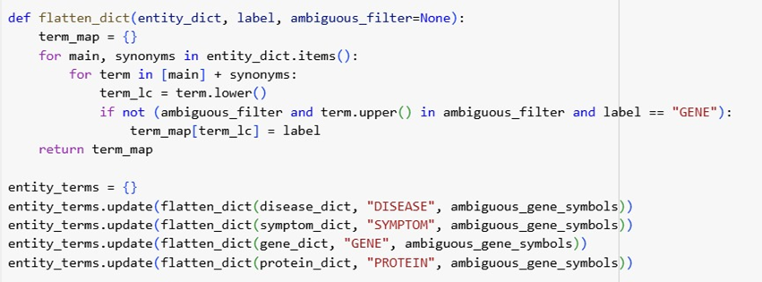

Slide 14
Data Annotation
06

Slide 15
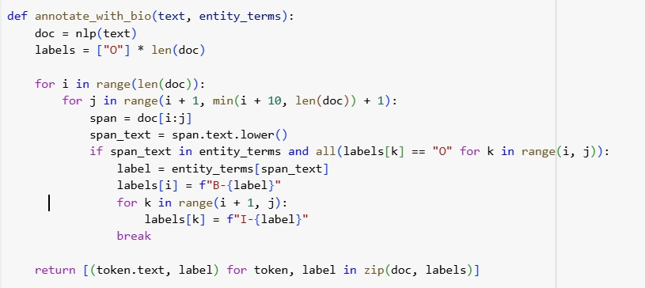

Slide 16
Data Volume
07

Slide 17
Querying PubMed:
30 distinct queries per entity type
4 entity types (disease, symptom, gene, protein)
50 abstracts retrieved per query
Total Abstracts:
30 queries/type×50 abstracts/query=1500 abstracts per entity type 4 entity types×1500 abstracts/type=6000 total abstracts
File Sizes (Post-preprocessing and Annotation):
pubmed_abstracts.txt (raw abstracts): 17.44 MB
pubmed_abstracts_labeled.txt (BIO-labeled CoNLL): 24.72 MB
biobert_ner_data.tsv (TSV-formatted for BioBERT): 24.72 MB

Slide 18
Models
08

Slide 19
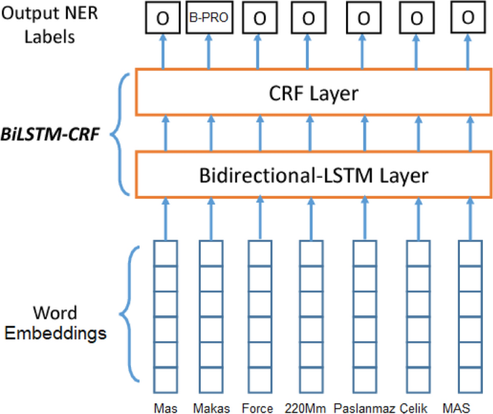
BiLSTM + CRF

Slide 20
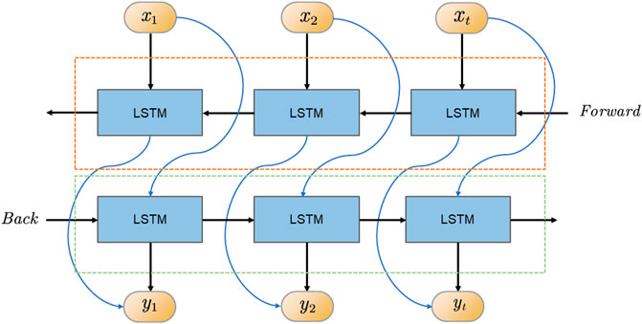
BiLSTM

Slide 21

Fine Tuning a Pretrained Model

Slide 22
Evaluation & Results
09

Slide 23
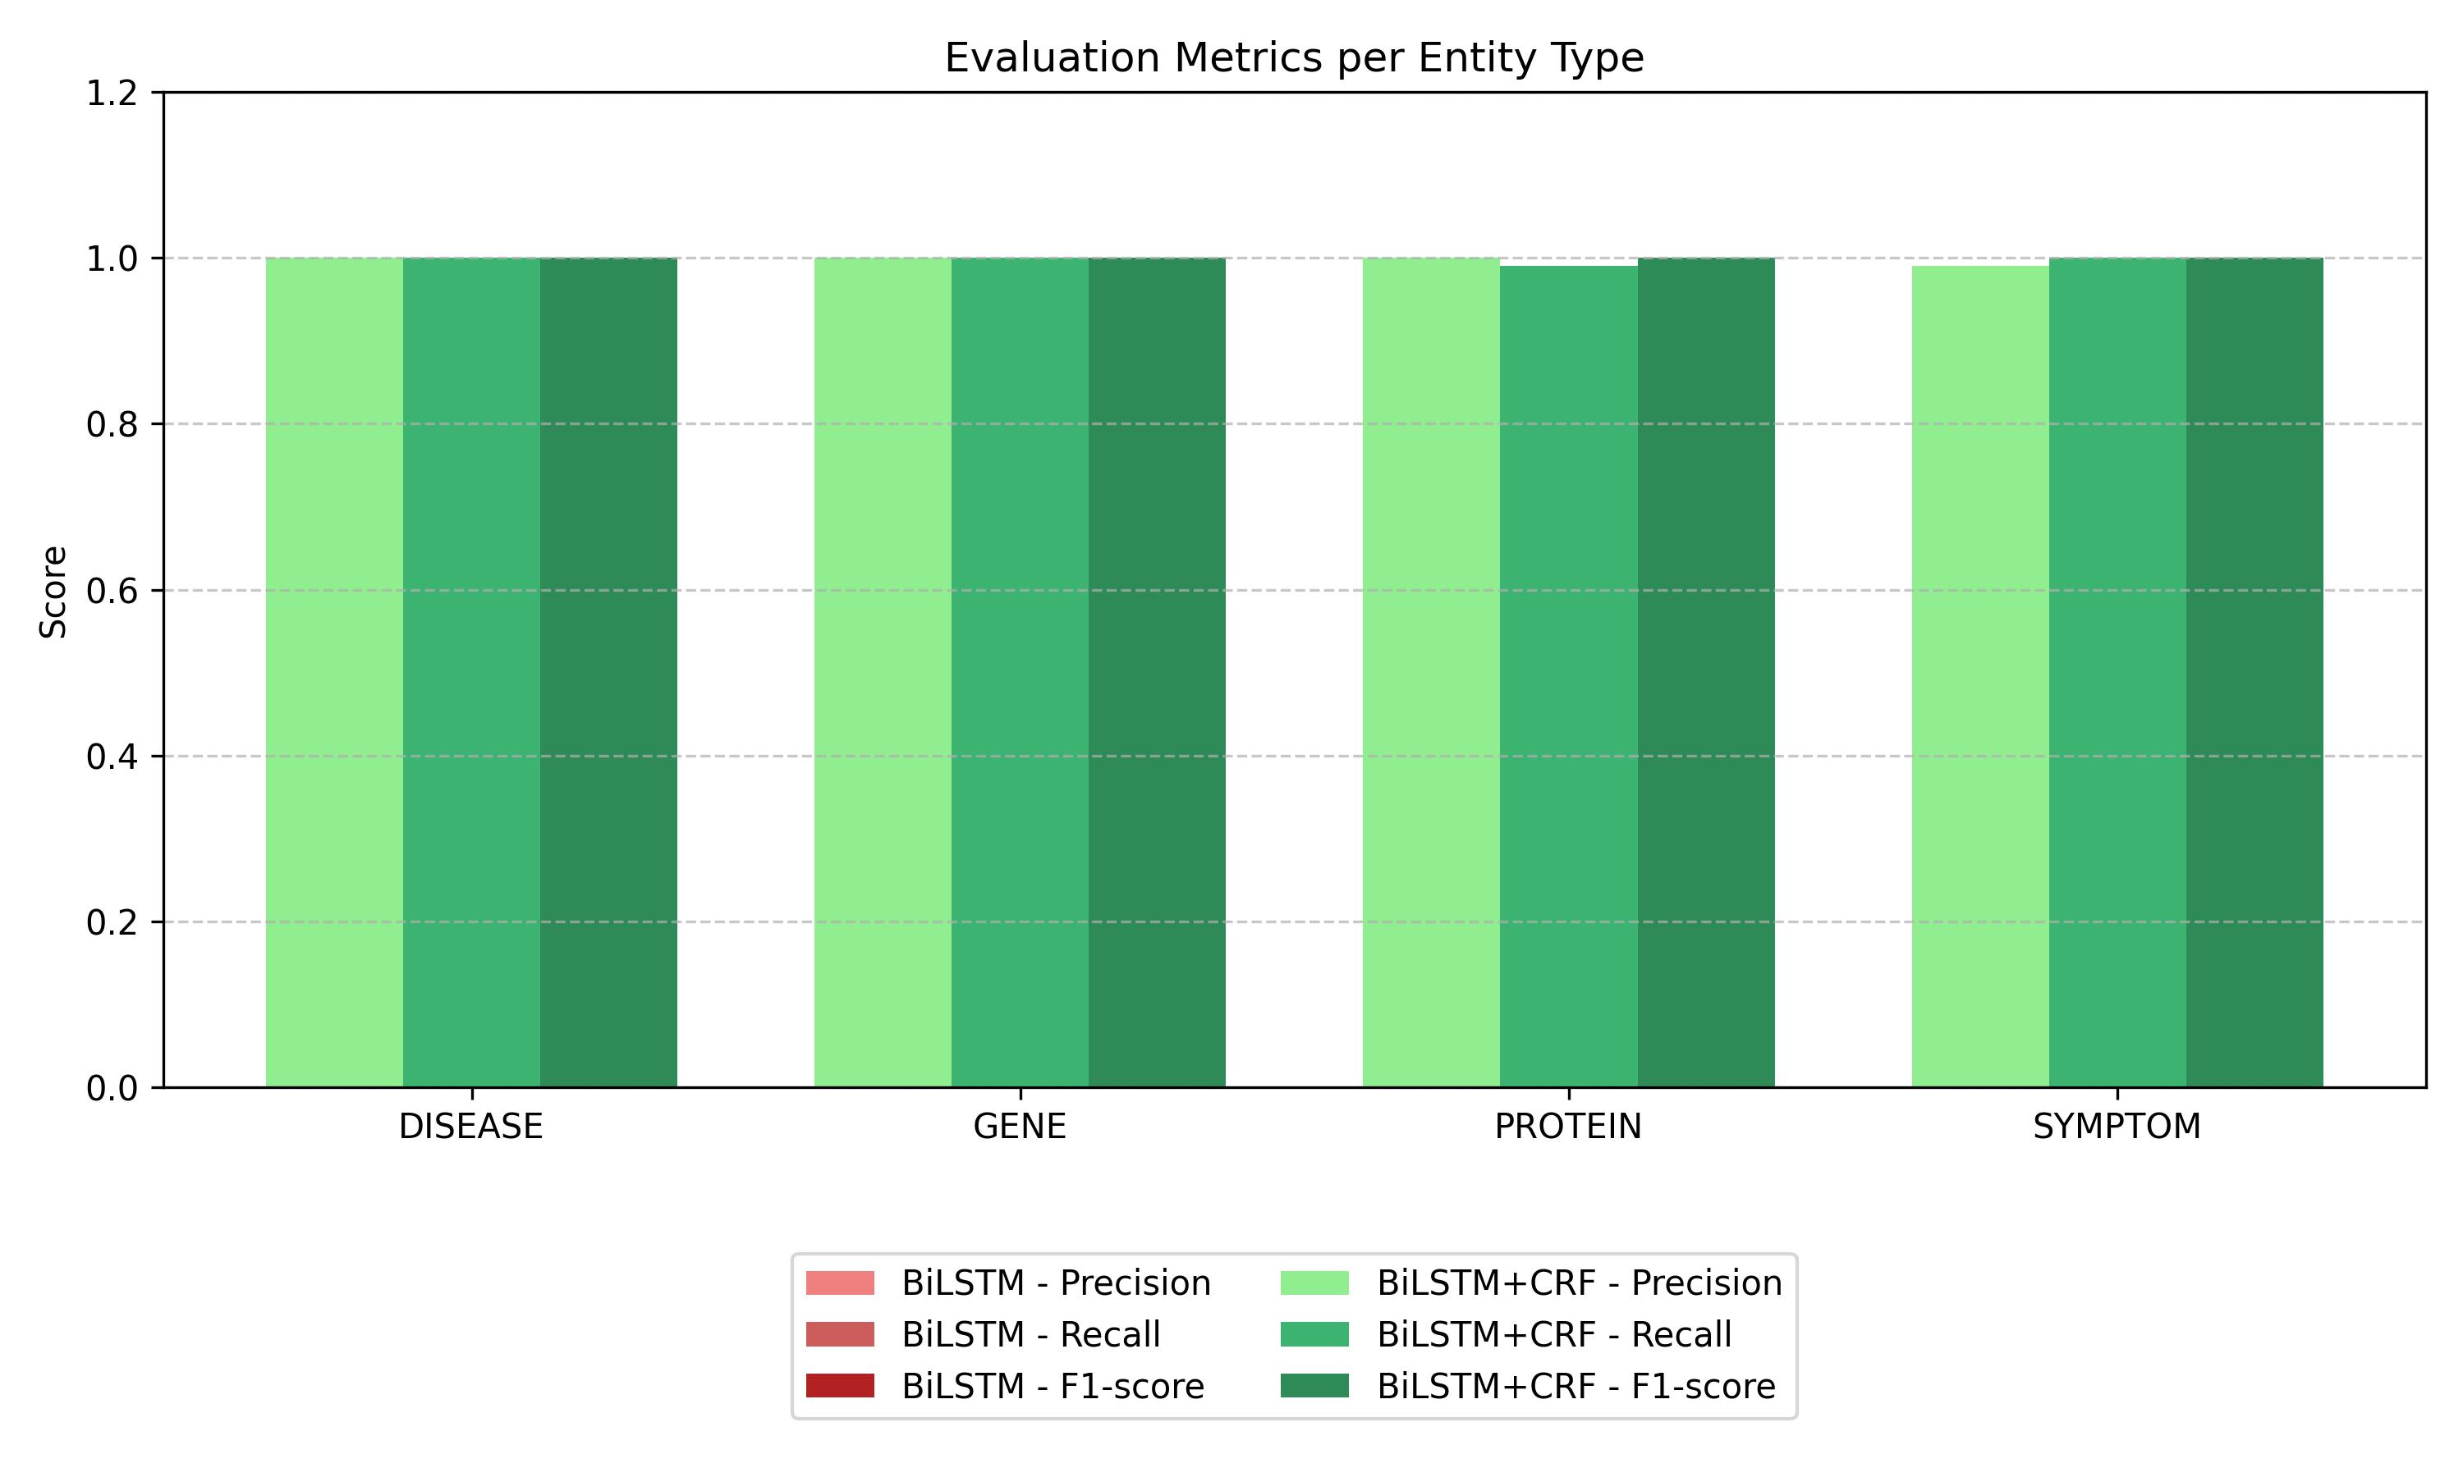

Slide 24
Discussion
10

Slide 25


Lack of a Structured Decoding Layer
Poor Generalization

Slide 26
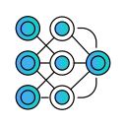

Use Pretrained Representation
Improve Data Quality and Labeling

Slide 27
Ablation Test
11

Slide 28

Thank You

